Slide 1



Algorithm Design and Analysis Greedy Algorithms
http://ada.miulab.tw slido: #ADA2021
Yun-Nung (Vivian) Chen

Slide 2

Outline
Greedy Algorithms
Greedy #1: Activity-Selection / Interval Scheduling
Greedy #2: Coin Changing
Greedy #3: Fractional Knapsack Problem
Greedy #4: Huffman Codes
Greedy #5: Breakpoint Selection
Greedy #6: Task-Scheduling
Greedy #7: Scheduling to Minimize Lateness

Slide 3
Algorithm Design Strategy
Do not focus on “specific algorithms”
But “some strategies” to “design” algorithms
First Skill: Divide-and-Conquer (各個擊破/分治)
Second Skill: Dynamic Programming (動態規劃)
Third Skill: Greedy (貪婪法則)

Slide 4
Greedy Algorithms
Textbook Chapter 16 – Greedy Algorithms
Textbook Chapter 16.2 – Elements of the greedy strategy

Slide 5

What is Greedy Algorithms?
always makes the choice that looks best at the moment
makes a locally optimal choice in the hope that this choice will lead to a globally optimal solution
not always yield optimal solution; may end up at local optimal
global maximal
local maximal
local maximal
Greedy: move towards max gradient and hope it is global maximum

Slide 6
Algorithm Design Paradigms
Dynamic Programming
has optimal substructure
make an informed choice after getting optimal solutions to subproblems
dependent or overlapping subproblems
Greedy Algorithms
has optimal substructure
make a greedy choice before solving the subproblem
no overlapping subproblems
Each round selects only one subproblem
The subproblem size decreases
Possible Case 1
+
Subproblem Solution
Possible Case 2
+
Subproblem Solution
Optimal Solution
max
/min
Optimal Solution
Greedy Choice
Subproblem Solution
=
=
+
Possible Case k
Subproblem Solution
+

Slide 7
Greedy Procedure
Cast the optimization problem as one in which we make a choice and remain one subproblem to solve
Demonstrate the optimal substructure
Combining an optimal solution to the subproblem via greedy can arrive an optimal solution to the original problem
Prove that there is always an optimal solution to the original problem that makes the greedy choice

Slide 8
Greedy Algorithms
To yield an optimal solution, the problem should exhibit
Optimal Substructure : an optimal solution to the problem contains within its optimal solutions to subproblems
Greedy-Choice Property : making locally optimal (greedy) choices leads to a globally optimal solution

Slide 9
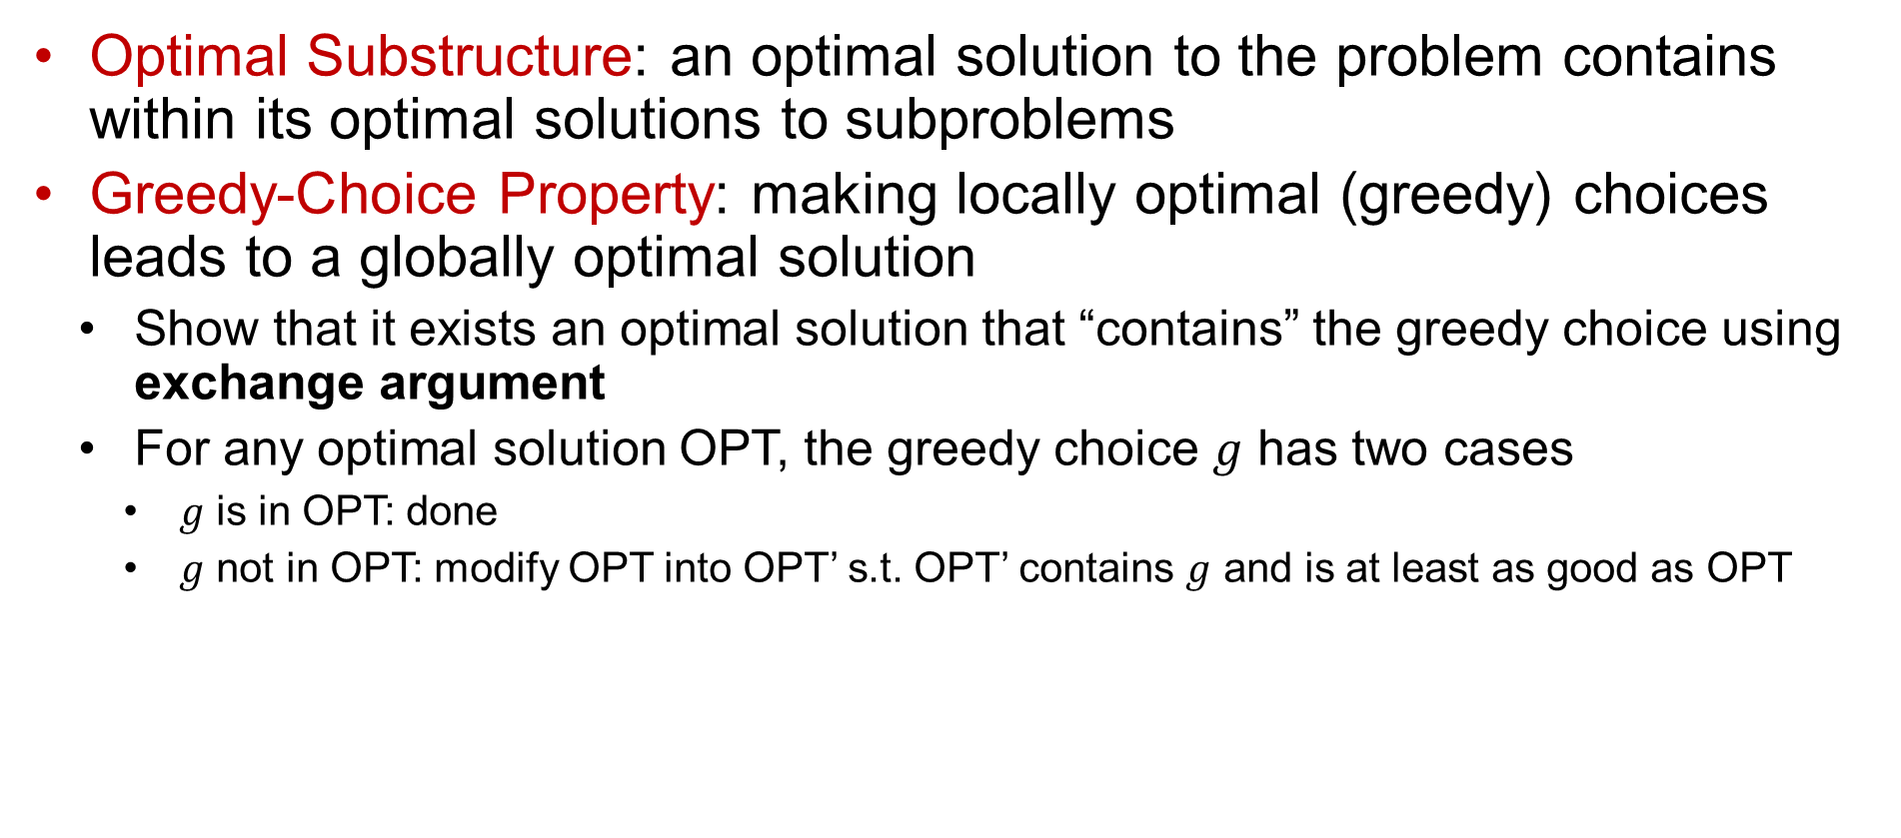
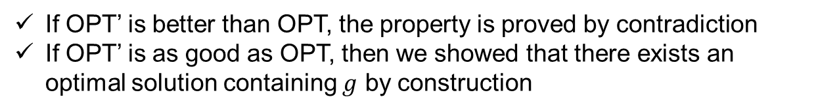

Proof of Correctness Skills
Optimal Substructure: an optimal solution to the problem contains within its optimal solutions to subproblems
Greedy-Choice Property: making locally optimal (greedy) choices leads to a globally optimal solution
Show that it exists an optimal solution that “contains” the greedy choice using exchange argument
For any optimal solution OPT, the greedy choice $g$ has two cases
$g$ is in OPT: done
$g$ not in OPT: modify OPT into OPT’ s.t. OPT’ contains $g$ and is at least as good as OPT
OPT
OPT’
If OPT’ is better than OPT, the property is proved by contradiction
If OPT’ is as good as OPT, then we showed that there exists an optimal solution containing $g$ by construction
$$g$$

Slide 10
Greedy #1: Activity-Selection
/ Interval Scheduling
Textbook Chapter 16.1 – An activity-selection problem

Slide 11

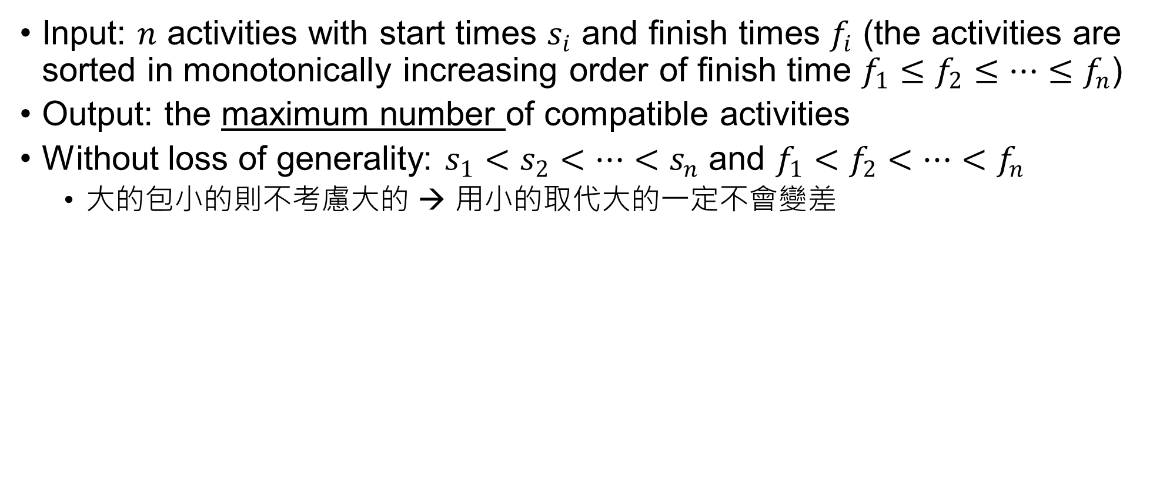
Activity-Selection/ Interval Scheduling
Input: $n$ activities with start times $s_{i}$ and finish times $f_{i}$ (the activities are sorted in monotonically increasing order of finish time $f_{1}≤f_{2}≤…≤f_{n}$)
Output: the maximum number of compatible activities
Without loss of generality: $s_{1}<s_{2}<…<s_{n}$ and $f_{1}<f_{2}<…<f_{n}$
大的包小的則不考慮大的 → 用小的取代大的一定不會變差
activity index
1
2
3
4
5
6
time
1
2
3
4
5
6
7
8
9

Slide 12

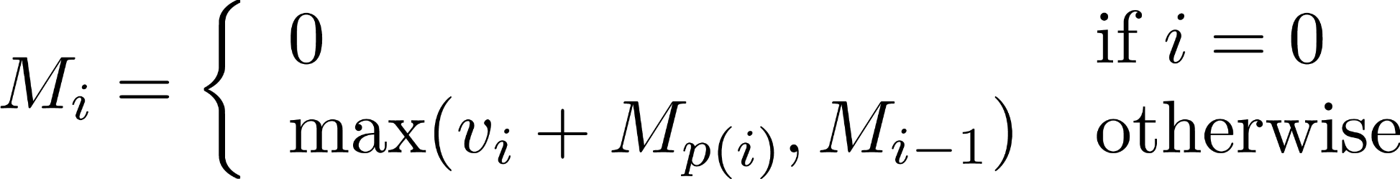
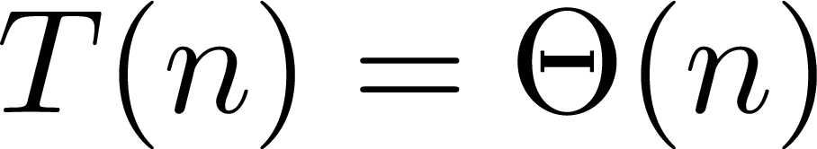
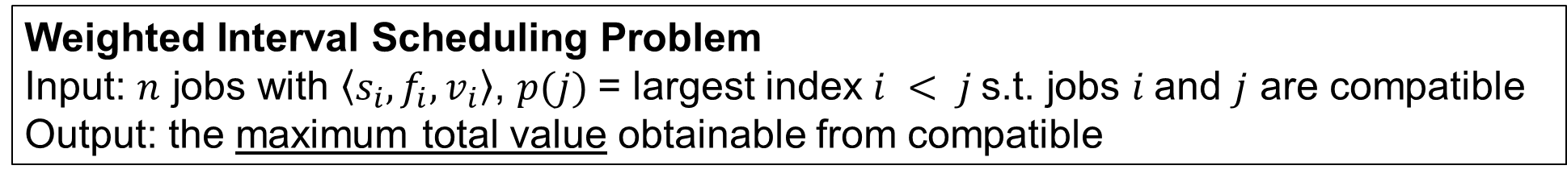
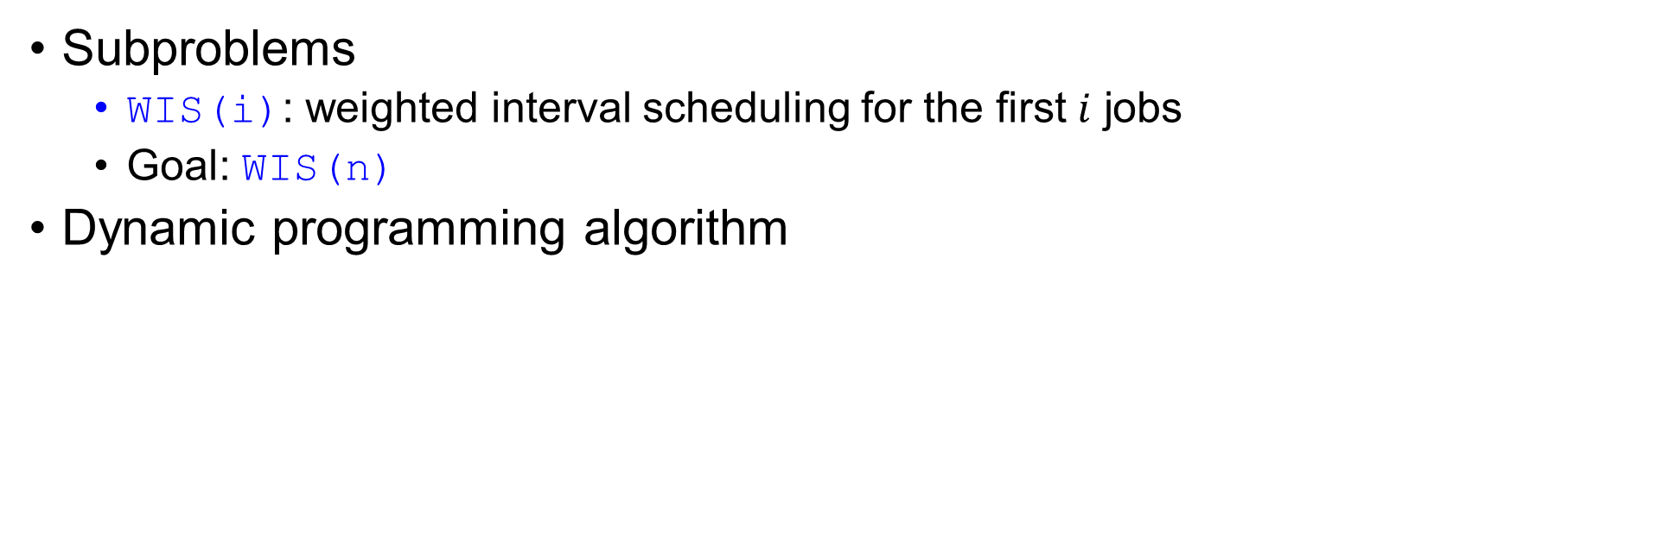
Weighted Interval Scheduling
Weighted Interval Scheduling Problem
Input: $n$ jobs with $\left\langle s_{i},f_{i},v_{i}\right\rangle$, $p(j)$= largest index $i < j$s.t. jobs $i$and $j$ are compatible
Output: the maximum total value obtainable from compatible
Subproblems
WIS(i): weighted interval scheduling for the first $i$ jobs
Goal: WIS(n)
Dynamic programming algorithm
i | 0 | 1 | 2 | 3 | 4 | 5 | … | n
M[i]
Set $v_{i}=1$ for all $i$ to formulate it into the activity-selection problem

Slide 13
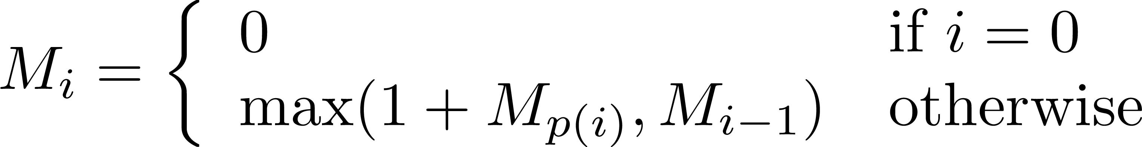
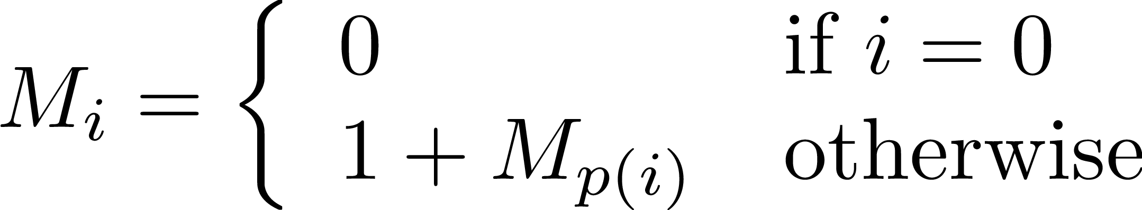

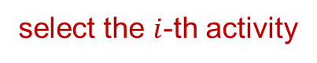
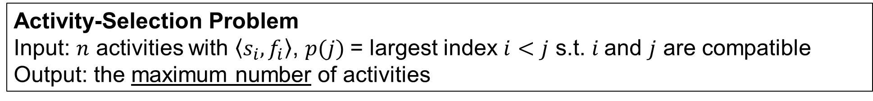
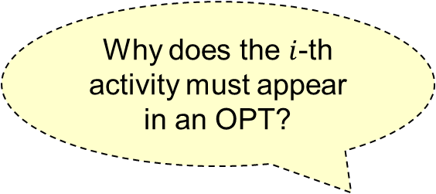
Activity-Selection Problem
Activity-Selection Problem
Input: $n$ activities with $\left\langle s_{i},f_{i}\right\rangle$, $p(j)$= largest index $i<j$ s.t. $i$and $j$ are compatible
Output: the maximum number of activities
Dynamic programming
Optimal substructure is already proved
Greedy algorithm
Why does the $i$-th activity must appear in an OPT?
select the $i$-th activity

Slide 14
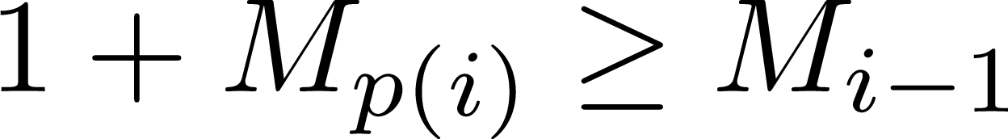
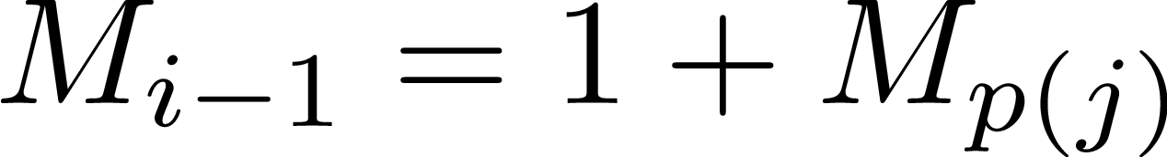
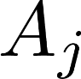
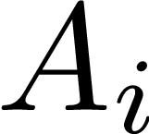
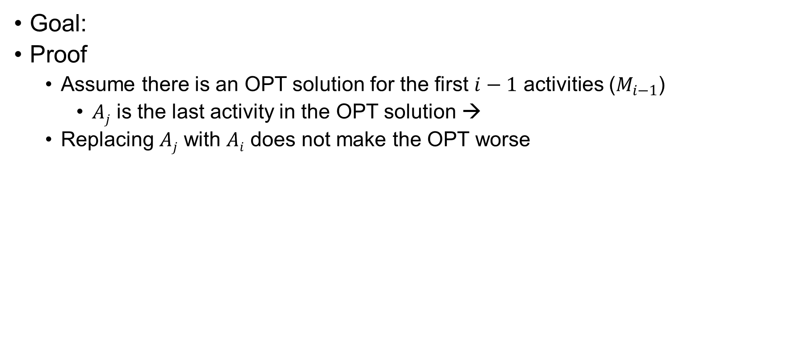
Greedy-Choice Property
Goal:
Proof
Assume there is an OPT solution for the first $i−1$ activities ($M_{i−1}$)
$Aj$ is the last activity in the OPT solution →
Replacing $Aj$ with $Ai$ does not make the OPT worse
activity index
1
2
:
i - 1
i
:
time
1
2
3
4
5
6
7
8
9

Slide 15
Pseudo Code
Activity-Selection Problem
Input: $n$ activities with $\left\langle s_{i},f_{i}\right\rangle$, $p(j)$= largest index $i<j$ s.t. $i$and $j$ are compatible
Output: the maximum number of activities
Act-Select(n, s, f, v, p)
M[0] = 0
for i = 1 to n
M[i] = 1 + M[p[i]]
return M[n]
Find-Solution(M, n)
if n = 0
return {}
return {n} ∪ Find-Solution(p[n])
Select the last compatible one (←) = Select the first compatible one (→)

Slide 16

Greedy #2: Coin Changing
Textbook Exercise 16.1

Slide 17
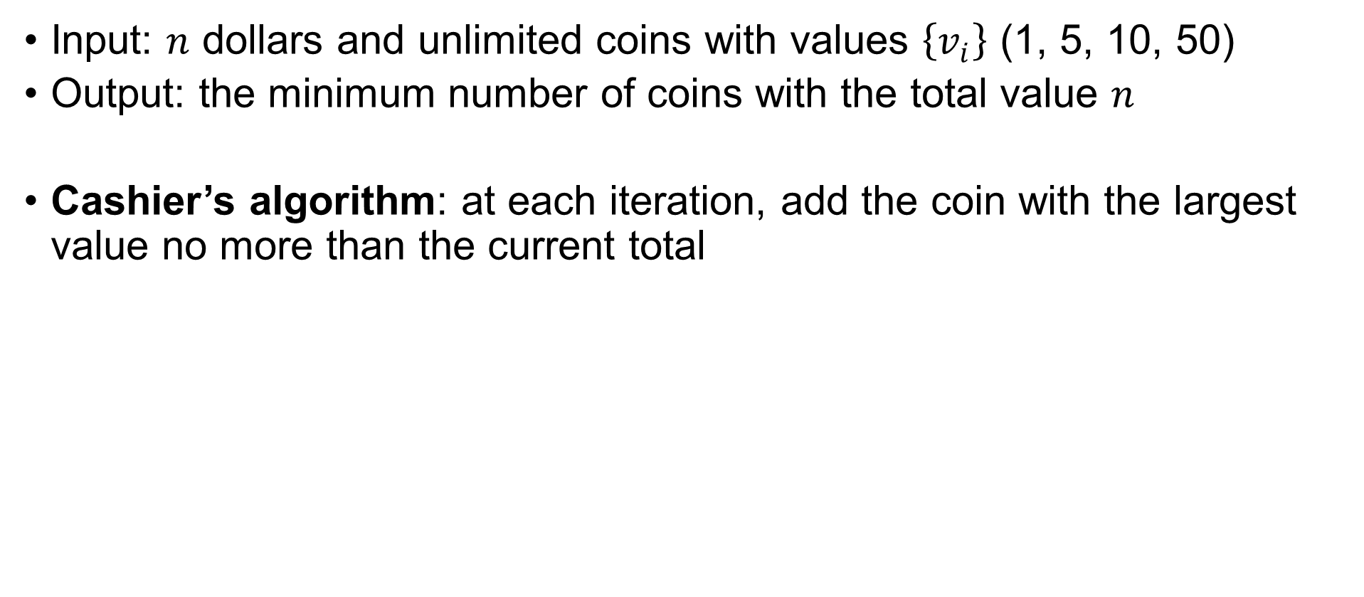
Coin Changing Problem
Input: $n$ dollars and unlimited coins with values $\left\{v_{i}\right\}$ (1, 5, 10, 50)
Output: the minimum number of coins with the total value $n$
Cashier’s algorithm: at each iteration, add the coin with the largest value no more than the current total
Does this algorithm return the OPT?

Slide 18
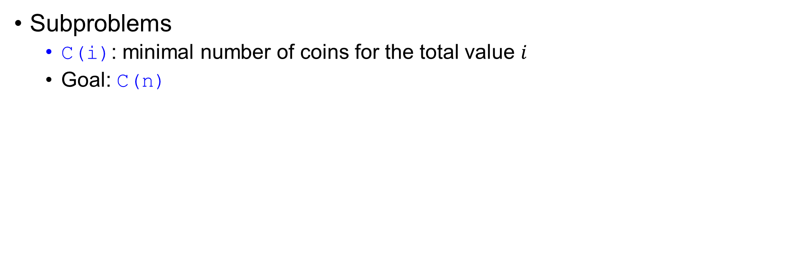
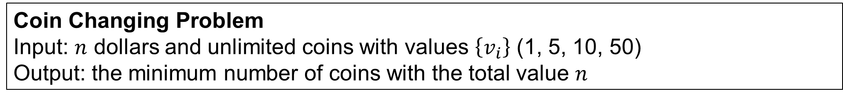
Step 1: Cast Optimization Problem
Coin Changing Problem
Input: $n$ dollars and unlimited coins with values $\left\{v_{i}\right\}$ (1, 5, 10, 50)
Output: the minimum number of coins with the total value $n$
Subproblems
C(i): minimal number of coins for the total value $i$
Goal: C(n)

Slide 19
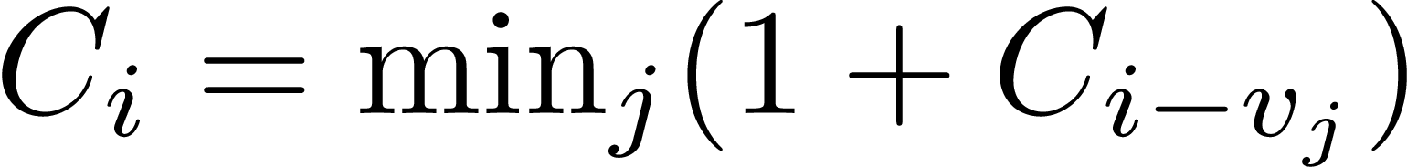
Step 2: Prove Optimal Substructure
Coin Changing Problem
Input: $n$ dollars and unlimited coins with values $\left\{v_{i}\right\}$ (1, 5, 10, 50)
Output: the minimum number of coins with the total value $n$
Suppose OPT is an optimal solution to C(i), there are 4 cases:
Case 1: coin 1 in OPT
OPT\coin1 is an optimal solution of C(i – v₁)
Case 2: coin 2 in OPT
OPT\coin2 is an optimal solution of C(i – v₂)
Case 3: coin 3 in OPT
OPT\coin3 is an optimal solution of C(i – v₃)
Case 4: coin 4 in OPT
OPT\coin4 is an optimal solution of C(i – v₄)

Slide 20
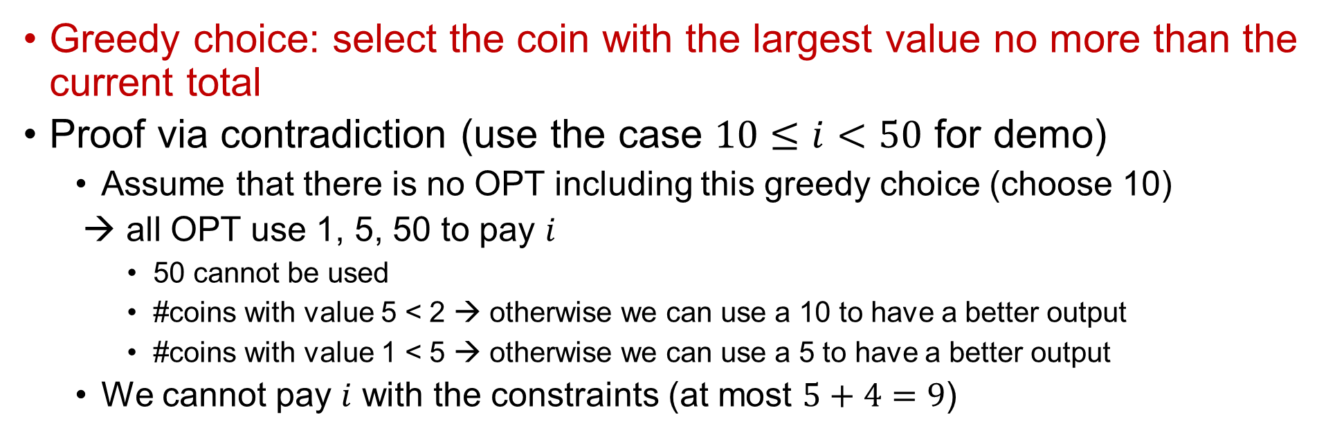
Step 3: Prove Greedy-Choice Property
Coin Changing Problem
Input: $n$ dollars and unlimited coins with values $\left\{v_{i}\right\}$ (1, 5, 10, 50)
Output: the minimum number of coins with the total value $n$
Greedy choice: select the coin with the largest value no more than the current total
Proof via contradiction (use the case $10≤i<50$ for demo)
Assume that there is no OPT including this greedy choice (choose 10)
→ all OPT use 1, 5, 50 to pay $i$
50 cannot be used
#coins with value 5 < 2 → otherwise we can use a 10 to have a better output
#coins with value 1 < 5 → otherwise we can use a 5 to have a better output
We cannot pay $i$ with the constraints (at most $5+4=9$)

Slide 21
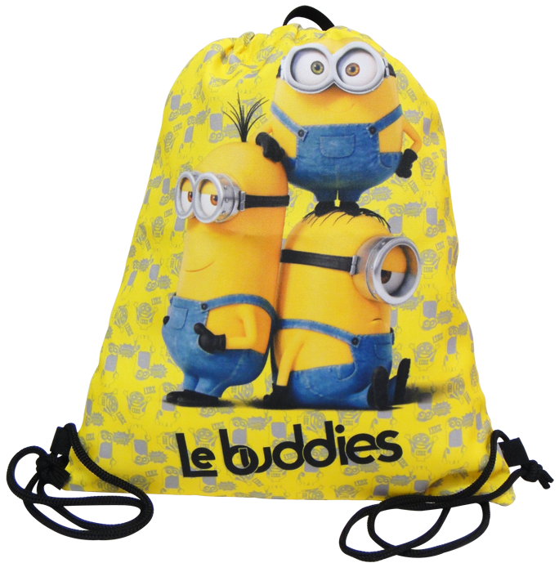
Greedy #3:
Fractional Knapsack Problem
Textbook Exercise 16.2-2

Slide 22

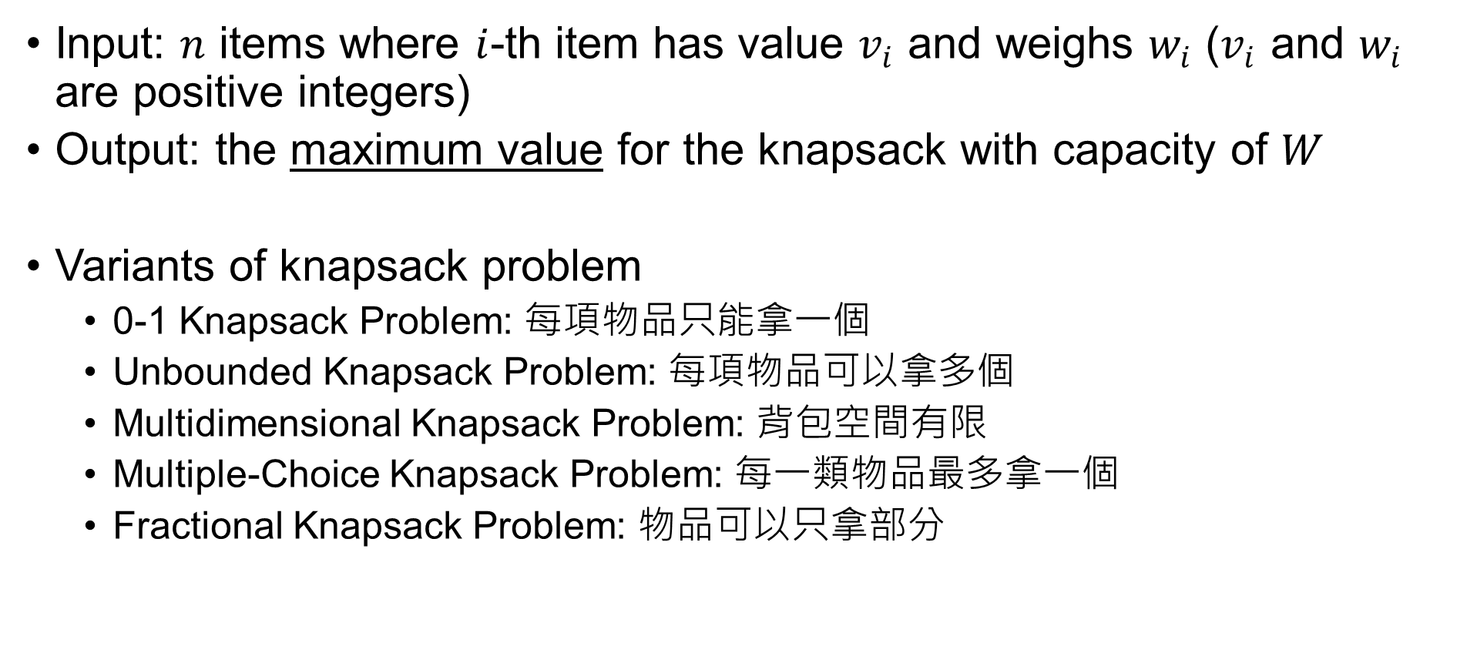
Knapsack Problem
Input: $n$ items where $i$-th item has value $v_{i}$ and weighs $w_{i}$ ($v_{i}$ and $w_{i}$ are positive integers)
Output: the maximum value for the knapsack with capacity of $W$
Variants of knapsack problem
0-1 Knapsack Problem: 每項物品只能拿一個
Unbounded Knapsack Problem: 每項物品可以拿多個
Multidimensional Knapsack Problem: 背包空間有限
Multiple-Choice Knapsack Problem: 每一類物品最多拿一個
Fractional Knapsack Problem: 物品可以只拿部分

Slide 23
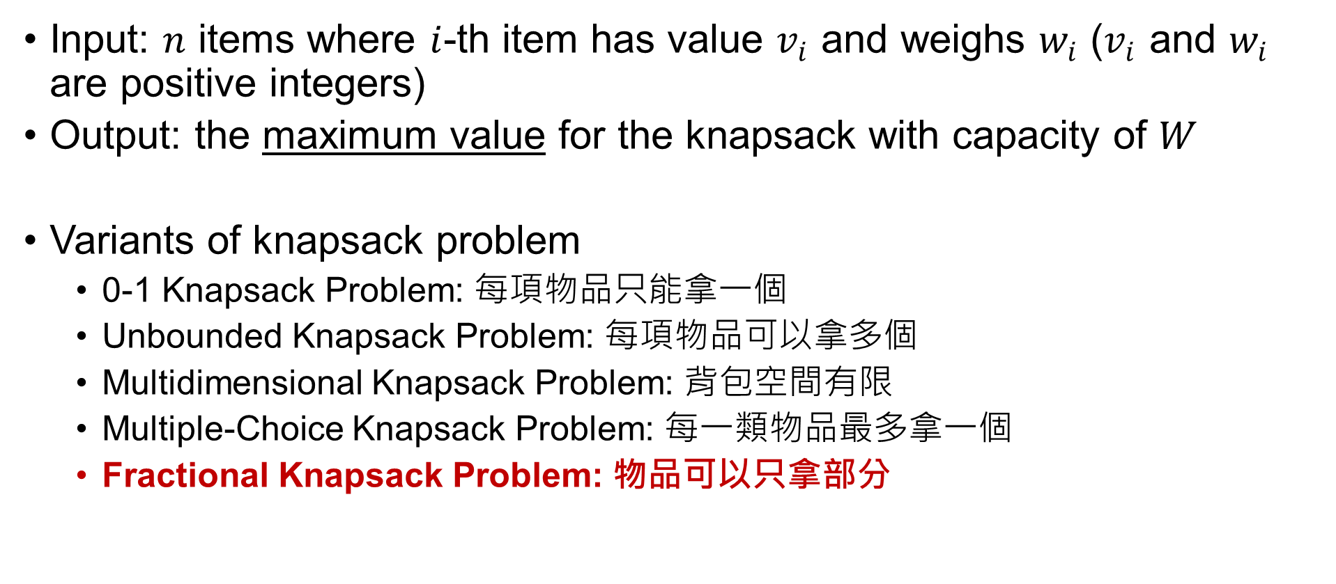
Knapsack Problem
Input: $n$ items where $i$-th item has value $v_{i}$ and weighs $w_{i}$ ($v_{i}$ and $w_{i}$ are positive integers)
Output: the maximum value for the knapsack with capacity of $W$
Variants of knapsack problem
0-1 Knapsack Problem: 每項物品只能拿一個
Unbounded Knapsack Problem: 每項物品可以拿多個
Multidimensional Knapsack Problem: 背包空間有限
Multiple-Choice Knapsack Problem: 每一類物品最多拿一個
Fractional Knapsack Problem: 物品可以只拿部分

Slide 24
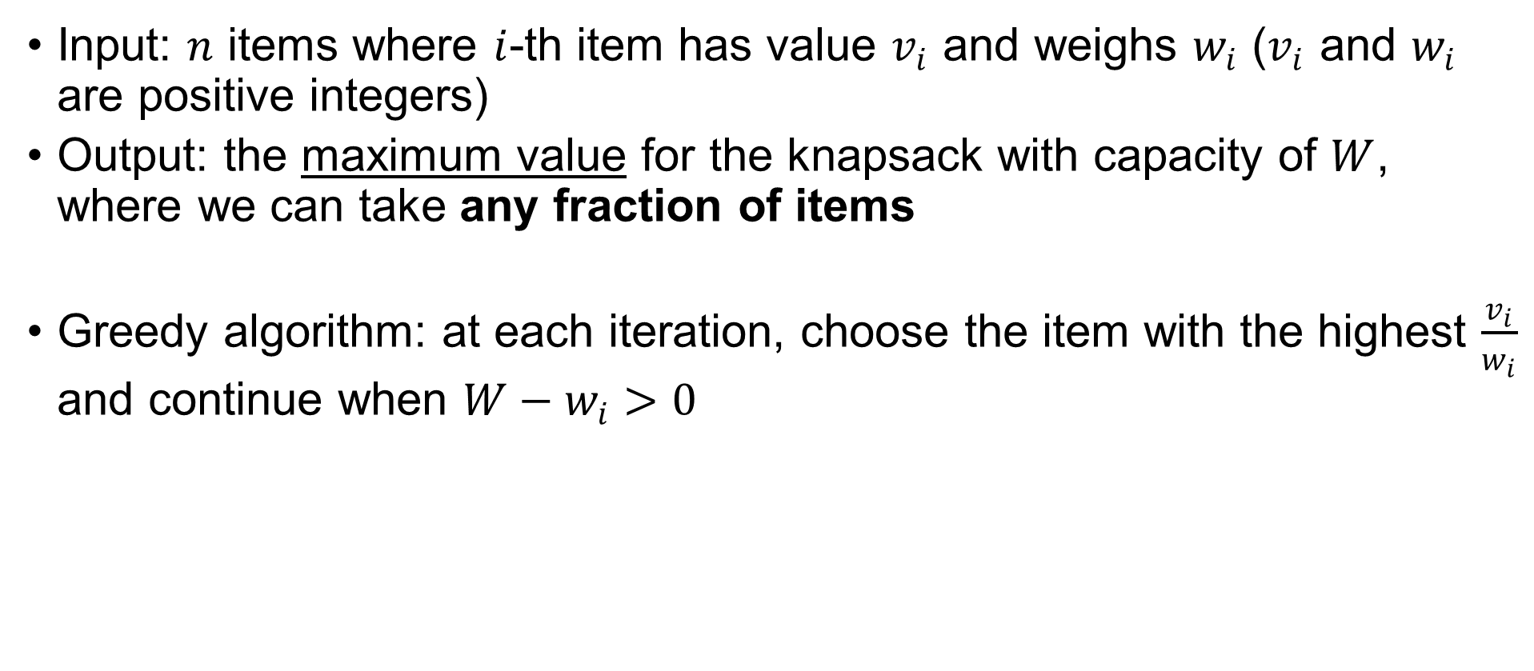
Fractional Knapsack Problem
Input: $n$ items where $i$-th item has value $v_{i}$ and weighs $w_{i}$ ($v_{i}$ and $w_{i}$ are positive integers)
Output: the maximum value for the knapsack with capacity of $W$, where we can take any fraction of items
Greedy algorithm: at each iteration, choose the item with the highest $\frac{v_{i}}{w_{i}}$ and continue when $W−w_{i}>0$

Slide 25
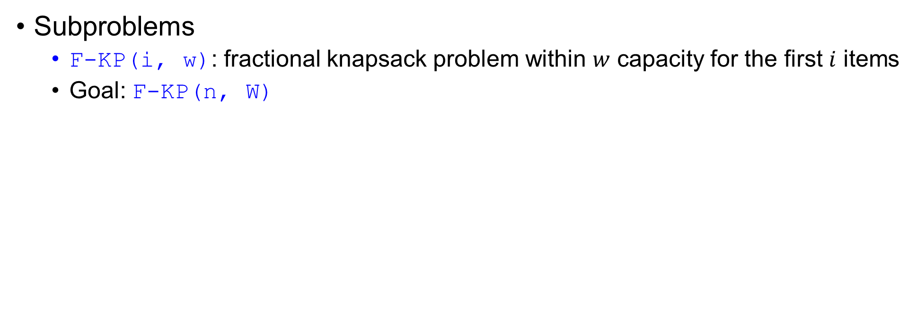
Step 1: Cast Optimization Problem
Fractional Knapsack Problem
Input: $n$ items where $i$-th item has value $v_{i}$ and weighs $w_{i}$
Output: the max value within $W$ capacity, where we can take any fraction of items
Subproblems
F-KP(i, w): fractional knapsack problem within $w$ capacity for the first $i$ items
Goal: F-KP(n, W)

Slide 26
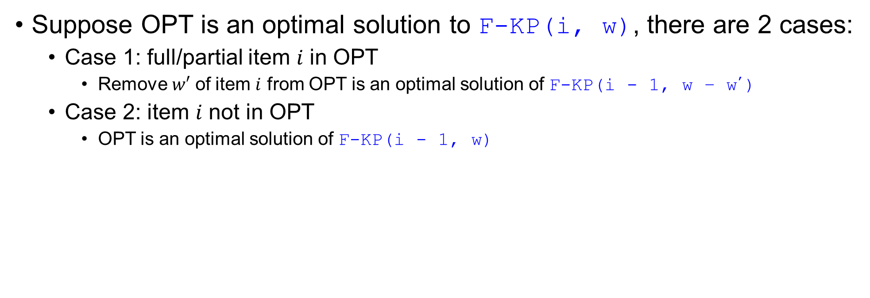
Step 2: Prove Optimal Substructure
Fractional Knapsack Problem
Input: $n$ items where $i$-th item has value $v_{i}$ and weighs $w_{i}$
Output: the max value within $W$ capacity, where we can take any fraction of items
Suppose OPT is an optimal solution to F-KP(i, w), there are 2 cases:
Case 1: full/partial item $i$ in OPT
Remove $w′$ of item $i$ from OPT is an optimal solution of F-KP(i - 1, w – w’)
Case 2: item $i$ not in OPT
OPT is an optimal solution of F-KP(i - 1, w)

Slide 27
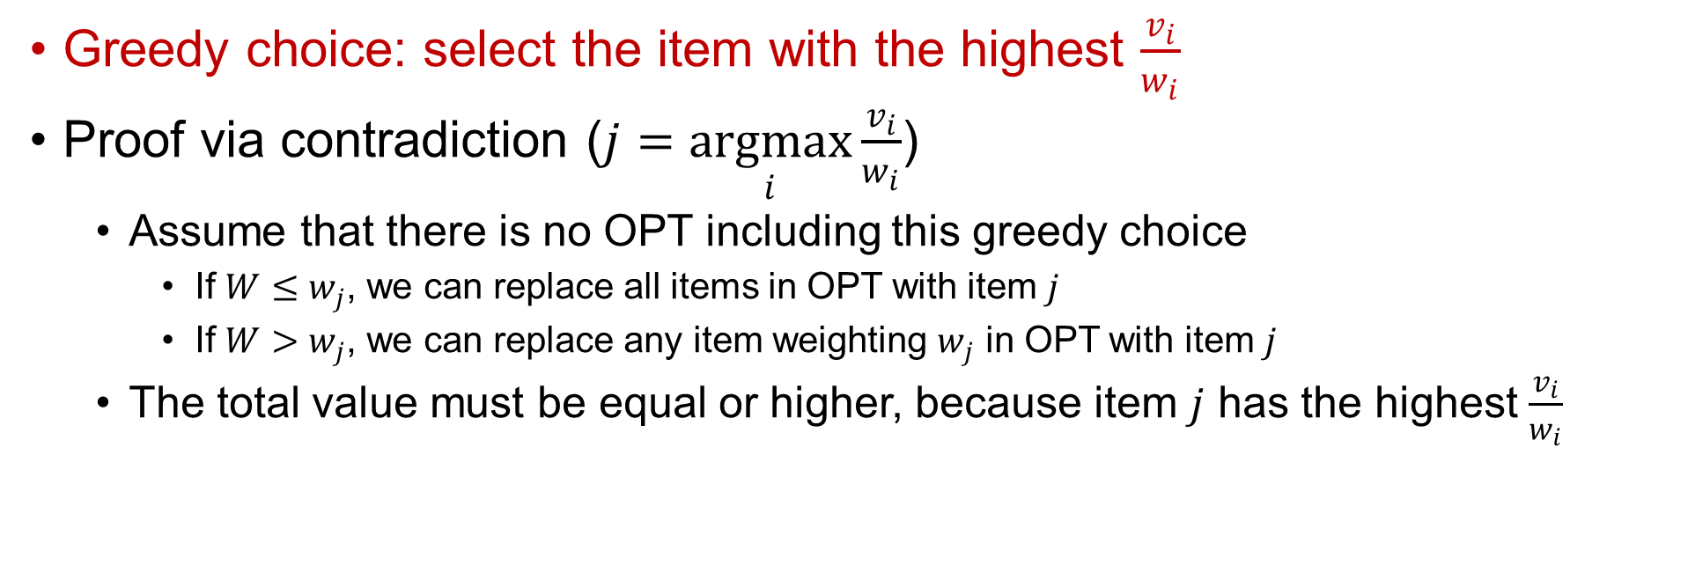
Step 3: Prove Greedy-Choice Property
Fractional Knapsack Problem
Input: $n$ items where $i$-th item has value $v_{i}$ and weighs $w_{i}$
Output: the max value within $W$ capacity, where we can take any fraction of items
Greedy choice: select the item with the highest $\frac{v_{i}}{w_{i}}$
Proof via contradiction ($j=\underset{i}{argmax}{\frac{v_{i}}{w_{i}}}$)
Assume that there is no OPT including this greedy choice
If $W≤w_{j}$, we can replace all items in OPT with item $j$
If $W>w_{j}$, we can replace any item weighting $w_{j}$ in OPT with item $j$
The total value must be equal or higher, because item $j$ has the highest $\frac{v_{i}}{w_{i}}$
Do other knapsack problems have this property?

Slide 28
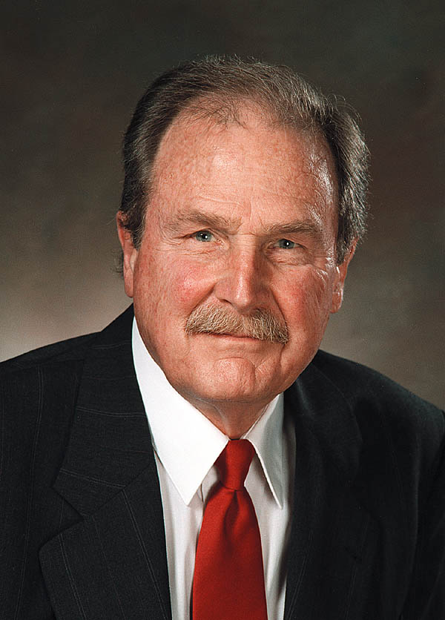
Greedy #4: Huffman Codes
Textbook Chapter 16.3 – Huffman codes

Slide 29
Encoding & Decoding
Code (編碼) is a system of rules to convert information—such as a letter, word, sound, image, or gesture—into another, sometimes shortened or secret, form or representation for communication through a channel or storage in a medium.
input message
Encoder
encoded message
Decoder
decoded message

Slide 30
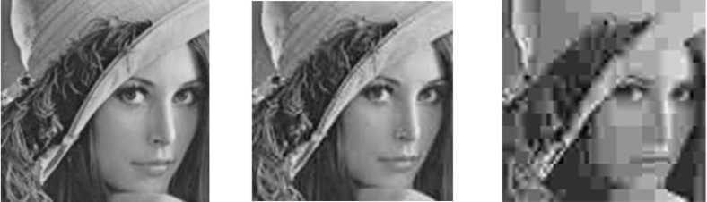
Encoding & Decoding
Goal
Enable communication and storage
Detect or correct errors introduced during transmission
Compress data: lossy or lossless
Encoder
536E6F6F7079
Decoder
Snoopy
Snoopy
Encoder
Decoder

Slide 31
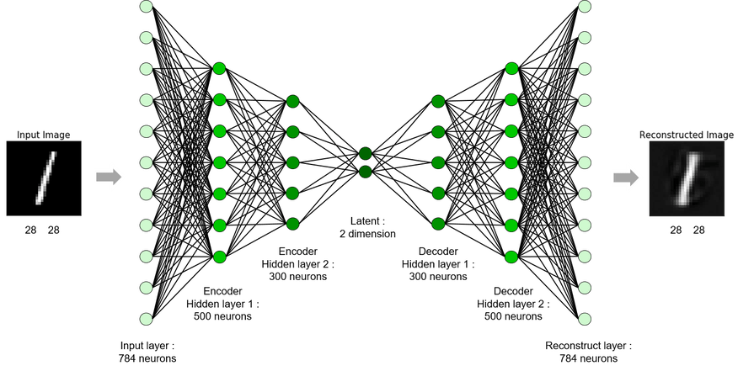
Lossy Data Compression: Autoencoder

Slide 32
Lossless Data Compression
Goal: encode each symbol using a unique binary code (w/o ambiguity)
How to represent symbols?
How to ensure decode(encode(x))=x?
How to minimize the number of bits?

Slide 33
Lossless Data Compression
Goal: encode each symbol using a unique binary code (w/o ambiguity)
How to represent symbols?
How to ensure decode(encode(x))=x?
How to minimize the number of bits?
find a binary tree
0
1
10101101011010100101010010
T T C G G T T T G G G A T
0
1
0
1
A
G
T
C

Slide 34
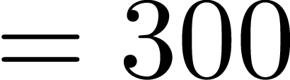
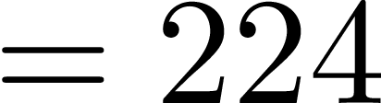
Symbol | A | B | C | D | E | F
Frequency (K) | 45 | 13 | 12 | 16 | 9 | 5
Fixed-length | 000 | 001 | 010 | 011 | 100 | 101
Variable-length | 0 | 101 | 100 | 111 | 1101 | 1100
Code
Fixed-length: use the same number of bits for encoding every symbol
Ex. ASCII, Big5, UTF
The length of this sequence is
Variable-length: shorter codewords for more frequent symbols
The length of this sequence is
0
1
1
A
0
1
0
0
1
0
0
1
0
1
C
B
D
0
1
0
1
0
1
0
1
A
B
C
D
E
F
E
F

Slide 35
Lossless Data Compression
Goal: encode each symbol using a unique binary code (w/o ambiguity)
How to represent symbols?
How to ensure decode(encode(x))=x?
How to minimize the number of bits?
use codes that are uniquely decodable

Slide 36
Prefix Code
Definition: a variable-length code where no codeword is a prefix of some other codeword
Ambiguity: decode(1011100) can be ‘BF’ or ‘CDAA’
Symbol |  | A | B | C | D | E | F
Frequency (K) |  | 45 | 13 | 12 | 16 | 9 | 5
Variable-length | Prefix code | 0 | 101 | 100 | 111 | 1101 | 1100
 | Not prefix code | 0 | 101 | 10 | 111 | 1101 | 1100
prefix codes are uniquely decodable

Slide 37
Lossless Data Compression
Goal: encode each symbol using a unique binary code (w/o ambiguity)
How to represent symbols?
How to ensure decode(encode(x))=x?
How to minimize the number of bits?
more frequent symbols should use shorter codewords

Slide 38
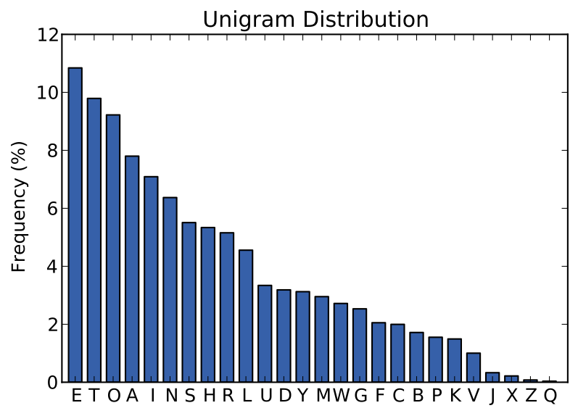
Letter Frequency Distribution
shorter codewords
longer codewords

Slide 39
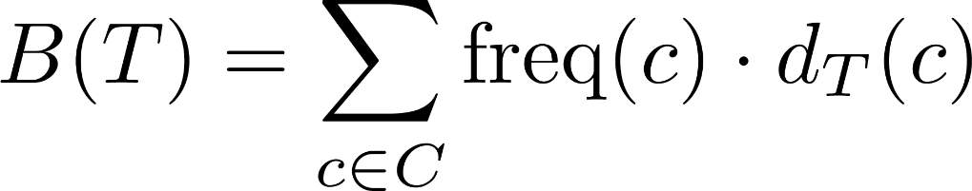
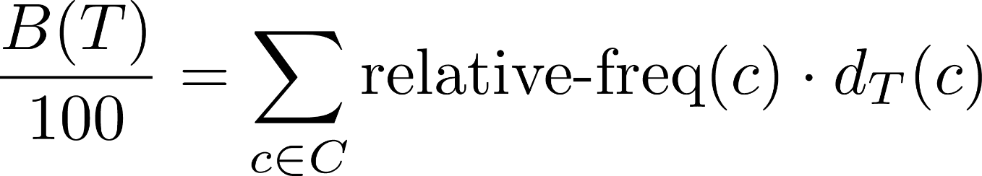
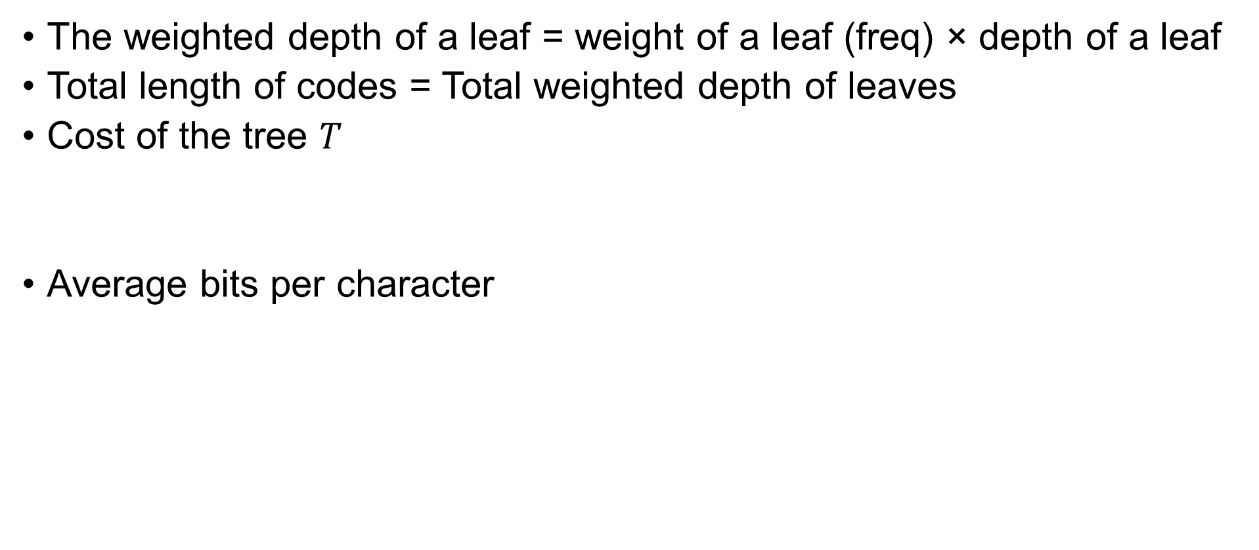
Total Length of Codes
The weighted depth of a leaf = weight of a leaf (freq) × depth of a leaf
Total length of codes = Total weighted depth of leaves
Cost of the tree $T$
Average bits per character
0
100
1
A:45
55
0
1
25
30
0
1
0
1
C:12
B:13
14
D:16
How to find the optimal prefix code to minimize the cost?
0
1
E:9
F:5

Slide 40
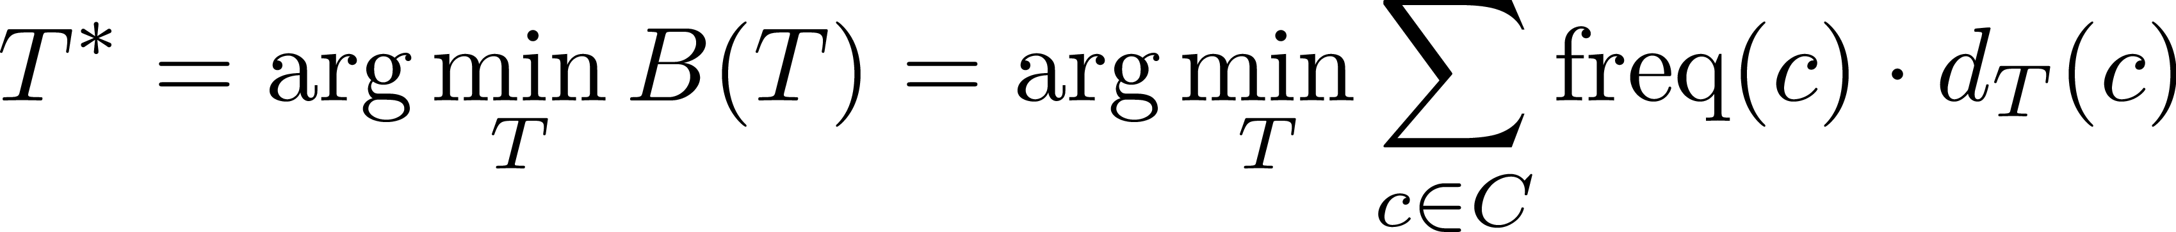
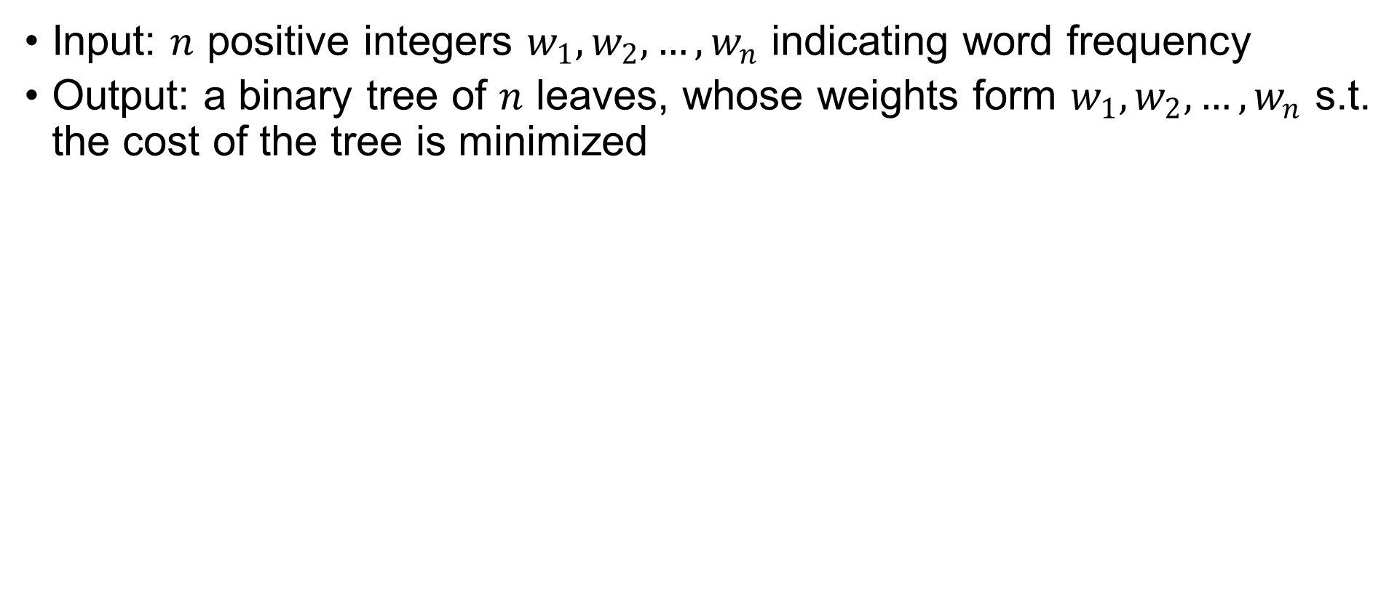
Prefix Code Problem
Input: $n$ positive integers $w_{1},w_{2}, …,w_{n}$ indicating word frequency
Output: a binary tree of $n$ leaves, whose weights form $w_{1},w_{2}, …,w_{n}$ s.t. the cost of the tree is minimized

Slide 41
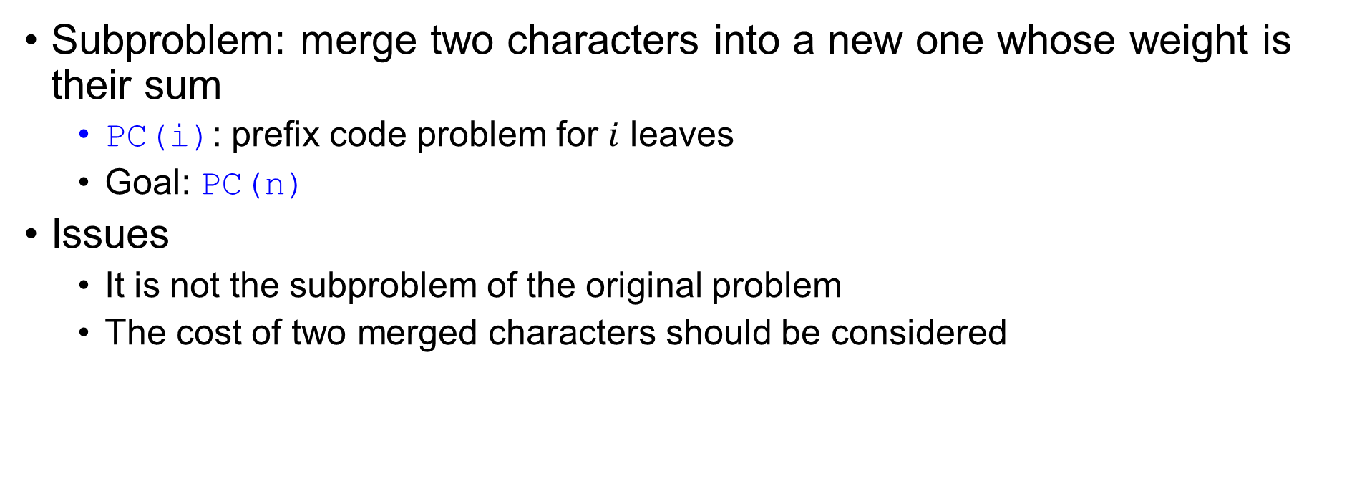
Step 1: Cast Optimization Problem
Prefix Code Problem
Input: $n$ positive integers $w_{1},w_{2}, …,w_{n}$ indicating word frequency
Output: a binary tree of $n$ leaves with minimal cost
Subproblem: merge two characters into a new one whose weight is their sum
PC(i): prefix code problem for $i$ leaves
Goal: PC(n)
Issues
It is not the subproblem of the original problem
The cost of two merged characters should be considered
PC(n) → PC(n - 1)

Slide 42
Example
0
100
1
0
100
1
A:45
55
A:45
55
0
1
0
1
25
30
25
30
0
1
0
1
0
1
0
1
C:12
B:13
14
D:16
C:12
B:13
EF:14
D:16
0
1
E:9
F:5

Slide 43
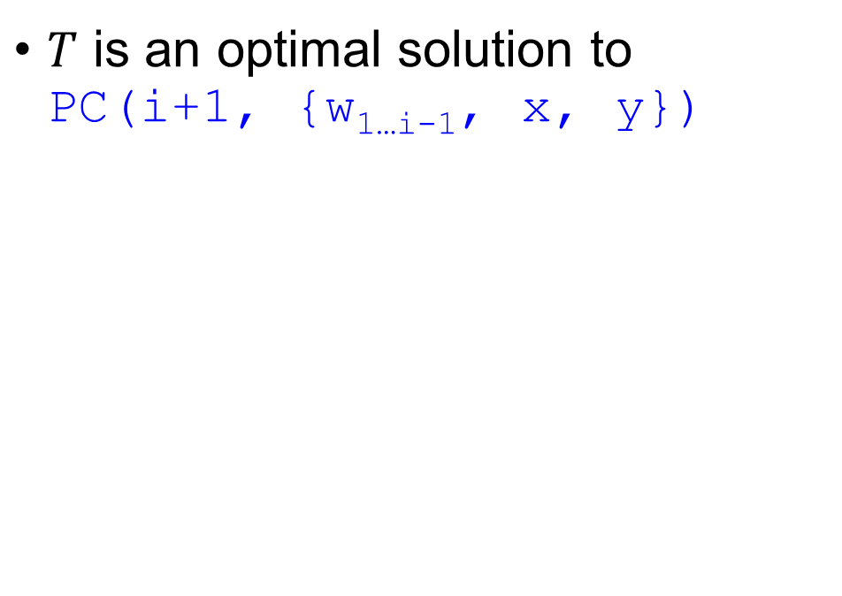
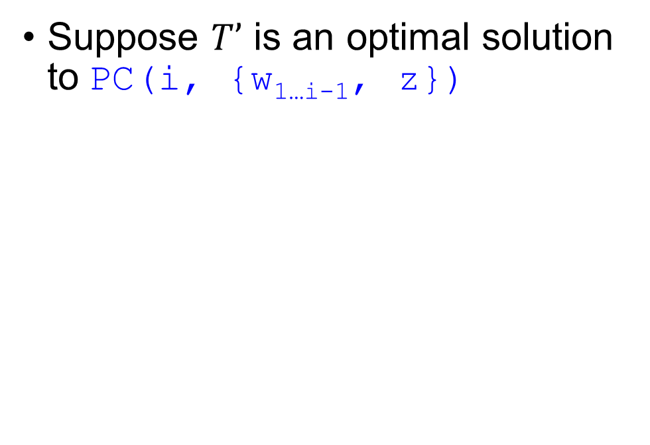
Step 2: Prove Optimal Substructure
Prefix Code Problem
Input: $n$ positive integers $w_{1},w_{2}, …,w_{n}$ indicating word frequency
Output: a binary tree of $n$ leaves with minimal cost
Suppose $T’$ is an optimal solution to PC(i, {w_{1…i-1}, z})
$T$ is an optimal solution to PC(i+1, {w_{1…i-1}, x, y})
z
x
y

Slide 44
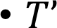
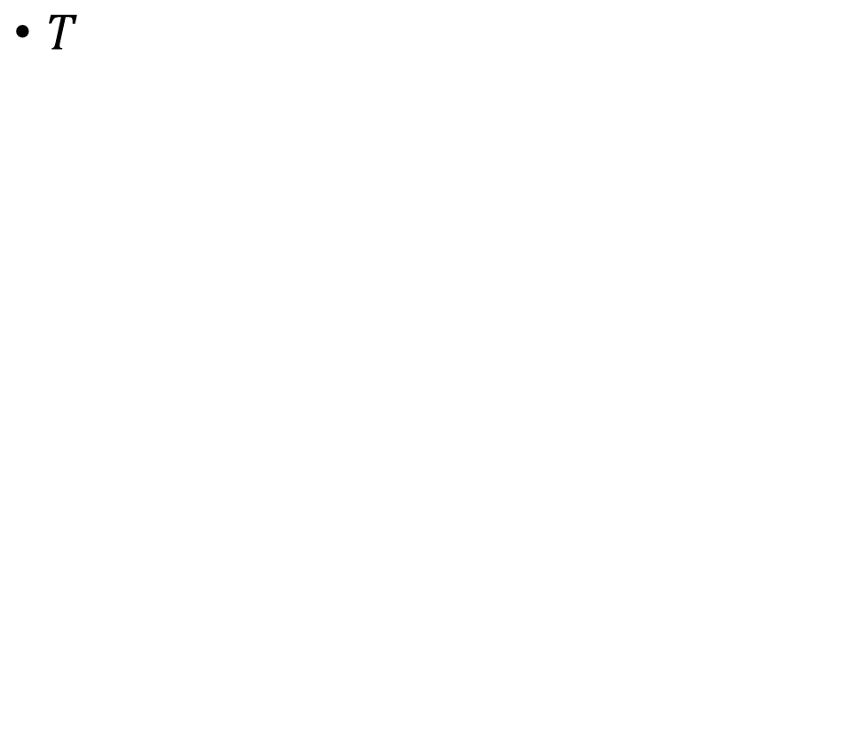
Step 2: Prove Optimal Substructure
$T’$
$T$
z
x
y

Slide 45
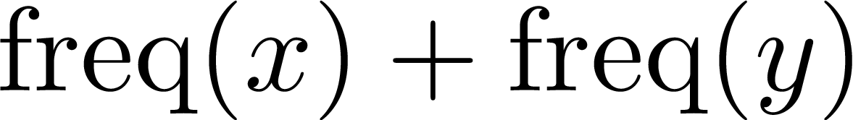
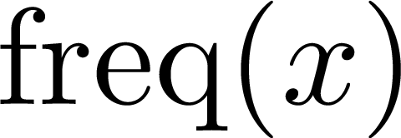
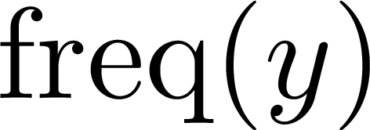
Step 2: Prove Optimal Substructure
Optimal substructure: T’ is OPT if and only if T is OPT
T’
T
The difference is

Slide 46
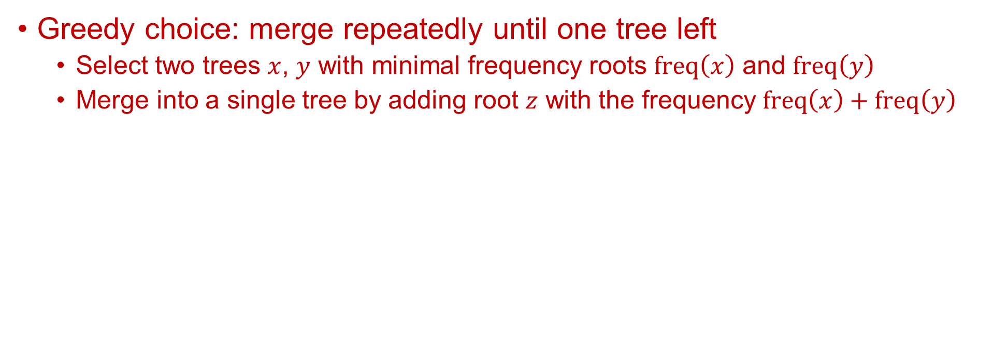
Greedy Algorithm Design
Prefix Code Problem
Input: $n$ positive integers $w_{1},w_{2}, …,w_{n}$ indicating word frequency
Output: a binary tree of $n$ leaves with minimal cost
Greedy choice: merge repeatedly until one tree left
Select two trees $x$, $y$ with minimal frequency roots $freq\left(x\right)$ and $freq\left(y\right)$
Merge into a single tree by adding root $z$ with the frequency $freq\left(x\right)+freq\left(y\right)$

Slide 47
Example
16
5
9
12
13
45
16
14
12
13
45
Initial set (store in a priority queue)
5
9

Slide 48
Example
16
14
25
45
16
14
12
13
45
5
9
12
13
5
9

Slide 49
Example
16
14
25
45
30
25
45
5
9
12
13
16
14
12
13
5
9

Slide 50
Example
55
45
30
25
45
30
25
16
14
12
13
16
14
12
13
5
9
5
9

Slide 51
Example
55
45
100
30
25
55
45
16
14
12
13
30
25
5
9
16
14
12
13
5
9

Slide 52
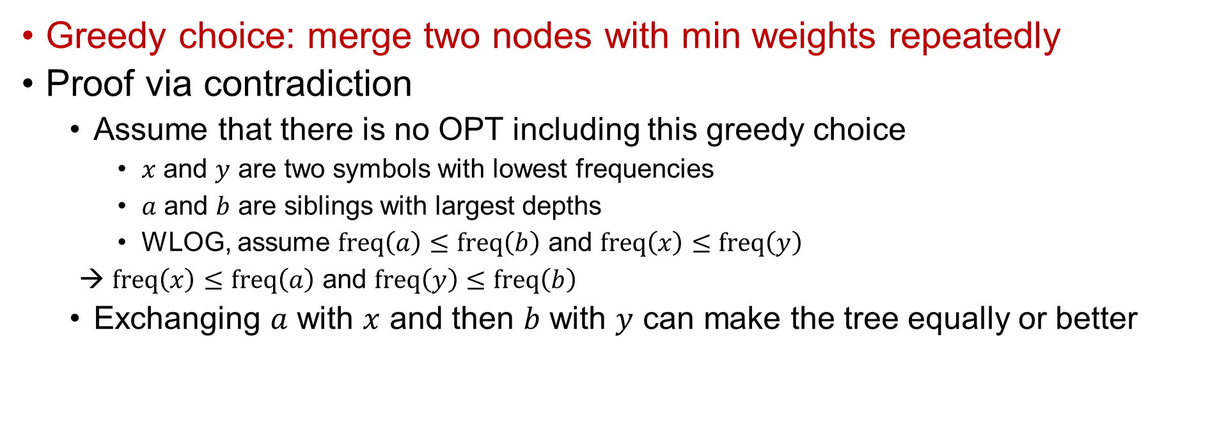
Step 3: Prove Greedy-Choice Property
Prefix Code Problem
Input: $n$ positive integers $w_{1},w_{2}, …,w_{n}$ indicating word frequency
Output: a binary tree of $n$ leaves with minimal cost
Greedy choice: merge two nodes with min weights repeatedly
Proof via contradiction
Assume that there is no OPT including this greedy choice
$x$ and $y$ are two symbols with lowest frequencies
$a$ and $b$ are siblings with largest depths
WLOG, assume $freq\left(a\right)≤freq\left(b\right)$ and $freq\left(x\right)≤freq\left(y\right)$
→ $freq\left(x\right)≤freq\left(a\right)$ and $freq\left(y\right)≤freq\left(b\right)$
Exchanging $a$ with $x$ and then $b$ with $y$ can make the tree equally or better
OPT: T
x
y
a
b

Slide 53



Step 3: Prove Greedy-Choice Property
OPT: T
T’
x
a
y
y
a
b
x
b
Because T is OPT, T’ must be another optimal solution.

Slide 54


Step 3: Prove Greedy-Choice Property
OPT: T
T’
T’’
x
a
a
y
y
b
a
b
x
b
x
y
Because T’ is OPT, T’’ must be another optimal solution.
Practice: prove the optimal tree must be a full tree

Slide 55

Correctness and Optimality
Theorem: Huffman algorithm generates an optimal prefix code
Proof
Use induction to prove: Huffman codes are optimal for $n$ symbols
$n=2$, trivial
For a set $S$ with $n+1$ symbols,
Based on the greedy choice property, two symbols with minimum frequencies are siblings in T
Construct T’ by replacing these two symbols $x$ and $y$ with $z$ s.t. $S′=(S\backslash \{x,y\})∪\left\{z\right\}$ and $freq\left(z\right)=freq\left(x\right)+freq\left(y\right)$
Assume T’ is the optimal tree for $n$ symbols by inductive hypothesis
Based on the optimal substructure property, we know that when T’ is optimal, T is optimal too (case $n+1$ holds)
This induction proof framework can be applied to prove its optimality using the optimal substructure and the greedy choice property.

Slide 56

Pseudo Code
Prefix Code Problem
Input: $n$ positive integers $w_{1},w_{2}, …,w_{n}$ indicating word frequency
Output: a binary tree of $n$ leaves with minimal cost
Huffman(S)
n = |S|
Q = Build-Priority-Queue(S)
for i = 1 to n – 1
allocate a new node z
z.left = x = Extract-Min(Q)
z.right = y = Extract-Min(Q)
freq(z) = freq(x) + freq(y)
Insert(Q, z)
Delete(Q, x)
Delete(Q, y)
return Extract-Min(Q) // return the prefix tree

Slide 57
Drawbacks of Huffman Codes
Huffman’s algorithm is optimal for a symbol-by-symbol coding with a known input probability distribution
Huffman’s algorithm is sub-optimal when
blending among symbols is allowed
the probability distribution is unknown
symbols are not independent

Slide 58
Greedy #5: Breakpoint Selection

Slide 59

Breakpoint Selection Problem
Input: a planned route with $n+1$ gas stations $b_{0},…,b_{n}$; the car can go at most $C$ after refueling at a breakpoint
Output: a refueling schedule ($b_{0}$→$b_{n}$) that minimizes the number of stops
Greedy algorithm: go as far as you can before refueling
Ideally: stop when out of gas
1
2
3
4
5
Actually: may not be able to find the gas station when out of gas
1
2
3
4
5
6

Slide 60

Step 1: Cast Optimization Problem
Breakpoint Selection Problem
Input: $n+1$ breakpoints $b_{0},…,b_{n}$; gas storage is $C$
Output: a refueling schedule ($b_{0}$→$b_{n}$) that minimizes the number of stops
Subproblems
B(i): breakpoint selection problem from $b_{i}$to $b_{n}$
Goal: B(0)

Slide 61


Step 2: Prove Optimal Substructure
Breakpoint Selection Problem
Input: $n+1$ breakpoints $b_{0},…,b_{n}$; gas storage is $C$
Output: a refueling schedule ($b_{0}$→$b_{n}$) that minimizes the number of stops
Suppose OPT is an optimal solution to B(i) where $j$ is the largest index satisfying $b_{j}−b_{i}≤C$, there are $j−i$ cases
Case 1: stop at $b_{i+1}$
OPT+{b_{i+1}} is an optimal solution of B(i + 1)
Case 2: stop at $b_{i+2}$
OPT+{b_{i+2}} is an optimal solution of B(i + 2)
:
Case $j−i$: stop at $b_{j}$
OPT+{b_{j}} is an optimal solution of B(j)

Slide 62


Step 3: Prove Greedy-Choice Property
Breakpoint Selection Problem
Input: $n+1$ breakpoints $b_{0},…,b_{n}$; gas storage is $C$
Output: a refueling schedule ($b_{0}$→$b_{n}$) that minimizes the number of stops
Greedy choice: go as far as you can before refueling (select $b_{j}$)
Proof via contradiction
Assume that there is no OPT including this greedy choice (after $b_{i}$ then stop at $b_{k}$, $k≠j$)
If $k>j$, we cannot stop at $b_{k}$ due to out of gas
If $k<j$, we can replace the stop at $b_{k}$with the stop at $b_{j}$
The total value must be equal or higher, because we refuel later ($b_{j}>b_{k}$)

Slide 63
Pseudo Code
Breakpoint Selection Problem
Input: $n+1$ breakpoints $b_{0},…,b_{n}$; gas storage is $C$
Output: a refueling schedule ($b_{0}$→$b_{n}$) that minimizes the number of stops
BP-Select(C, b)
Sort(b) s.t. b[0] < b[1] < … < b[n]
p = 0
S = {0}
for i = 1 to n - 1
if b[i + 1] – b[p] > C
if i == p
return “no solution”
A = A ∪ {i}
p = i
return A

Slide 64

To Be Continued…

Slide 65
Question?
Important announcement will be sent to @ntu.edu.tw mailbox & post to the course website
Course Website: http://ada.miulab.tw
Email: ada-ta@csie.ntu.edu.tw

